Slide 1
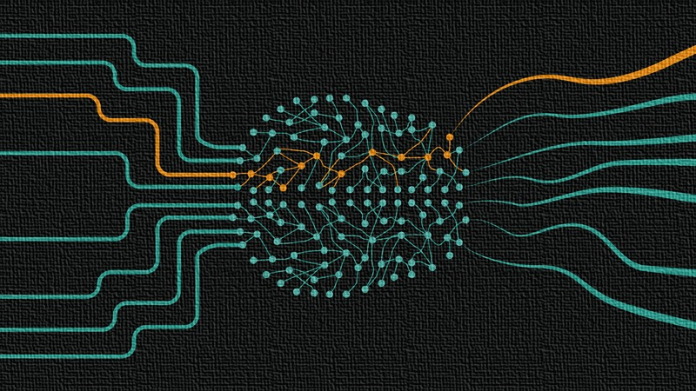
Resampling & Model Evaluation
Özgür Martin

Slide 2
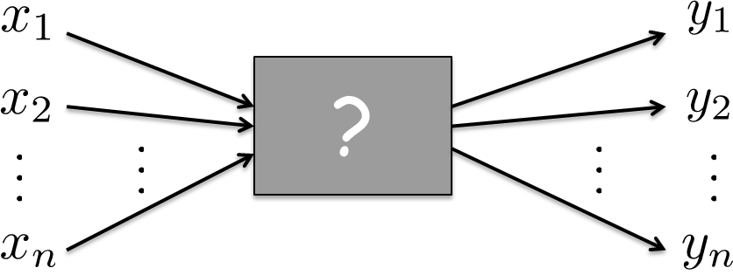
Regression
approximation?
training data
Training Mean Square Error (MSE)
Resampling & Model Evaluation
Özgür Martin

Slide 3



Expected test MSE:
variance
bias
Resampling & Model Evaluation
Özgür Martin

Slide 4
Expected test MSE:
Roughly:
Model
Complexity
Variance
Bias
Resampling & Model Evaluation
Özgür Martin

Slide 5
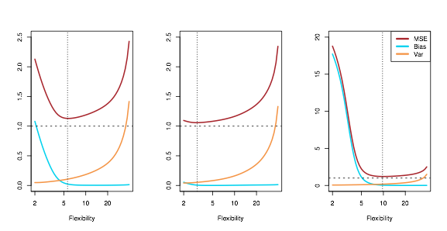
Resampling & Model Evaluation
Özgür Martin

Slide 6
Classification
?
output
variables
(categorical)
input
variables
training data
Training Error Rate
Resampling & Model Evaluation
Özgür Martin

Slide 7
K – Nearest Neighbors
Closeness???
K ???
voting
set of K
closest points to x₀
Resampling & Model Evaluation
Özgür Martin

Slide 8
Resampling & Model Evaluation
Özgür Martin

Slide 9

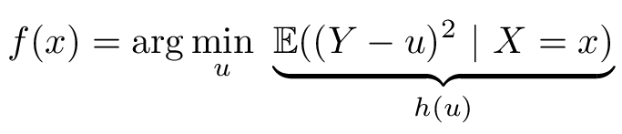
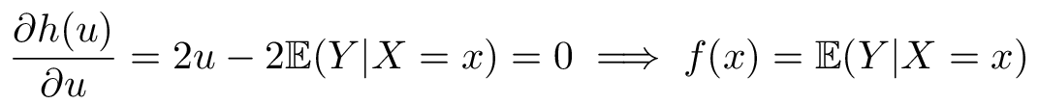

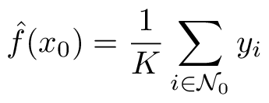
Regression
K-NN approximation to regression
Resampling & Model Evaluation
Özgür Martin

Slide 10

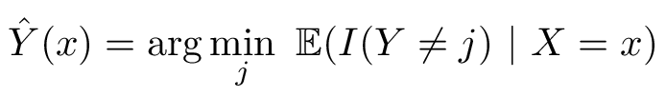
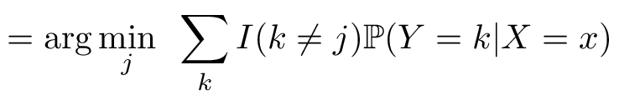
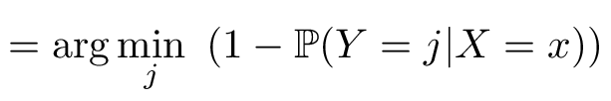
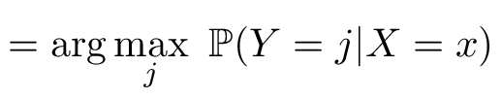
Classification
Resampling & Model Evaluation
Özgür Martin

Slide 11
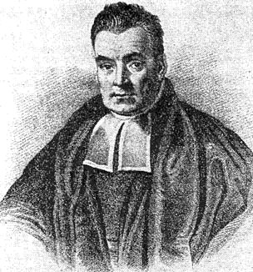
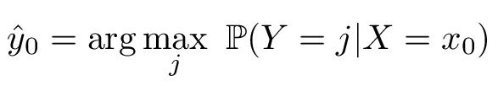
Bayes Classifier
(source)
Bayes Error Rate
Resampling & Model Evaluation
Özgür Martin

Slide 12
Resampling & Model Evaluation
Which predictor or classifier should we choose?
What is the generalization performance?
What do we mean by unseen (future) data?
How to select the parameters of the algorithms?
How about trying and comparing multiple algorithms?
What is the setup for fair performance evaluation and comparison?
Model Evaluation, Model Selection, and Algorithm Selection in Machine Learning, S. Raschka, arXiv:1811.1280v2, 3 Dec 2018.
Resampling & Model Evaluation
Özgür Martin

Slide 13
Generalization Performance (algorithm and its parameters are fixed)
Example 1: K-Nearest Neighbors (fixed K)
Example 2: Curve fitting with mth order polynomial (fixed m)
Model Selection (algorithm is fixed, its ‘best’ parameters are sought)
Hyperparameters: K=?, m=?, number of nodes=?, tree depth=?, …
Different hyperparameters (≠ model parameters) lead to different models
Algorithm Selection
K-NN?, curve fitting?, neural networks?, decision trees?, …
Resampling & Model Evaluation
Özgür Martin

Slide 14
Generalization Performance
Resubstitution
Data
Algorithm
Model
performance?
Data
Training
(model fitting)
Testing
optimistic bias
Resampling & Model Evaluation
Özgür Martin

Slide 15
Generalization Performance
Holdout
Data
Training
Testing
training data
Algorithm
Model
performance?
test data
Resampling & Model Evaluation
Özgür Martin

Slide 16
Model Selection
Model
performance
Set of
Hyperparameters
Set 1
Algorithm
Model
performance
Set 2
selection?
…
…
Set m
Model
performance
Hypothesis Space
(Hypothesis ≅ Model)
Resampling & Model Evaluation
Özgür Martin

Slide 17
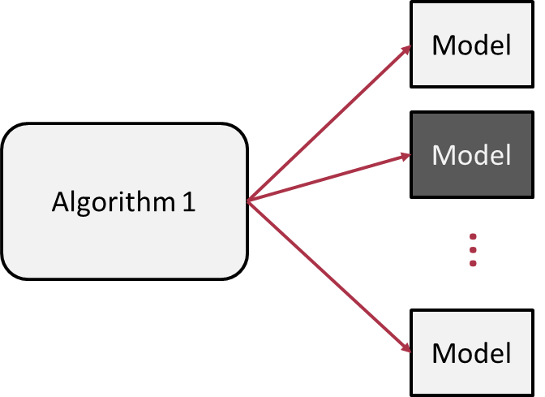
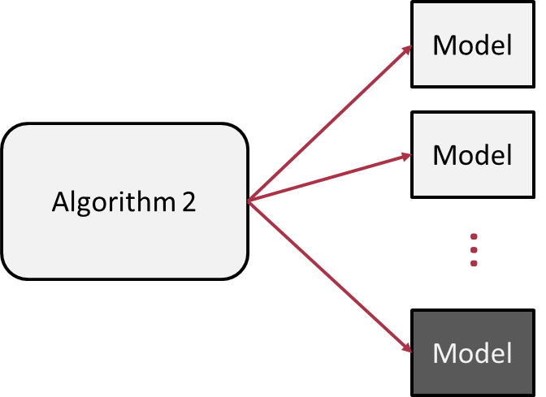
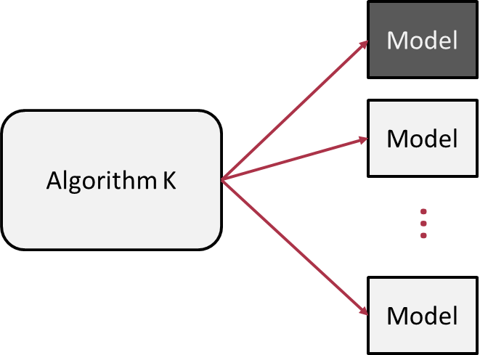
Algorithm Selection
Train (TR) - Validation (VA) - Test (TE)
Resampling
Cross-validation
Boostrapping
Bias – Variance trade-off
Data
TR
VA
TE
selection?
…
Resampling & Model Evaluation
Özgür Martin

Slide 18
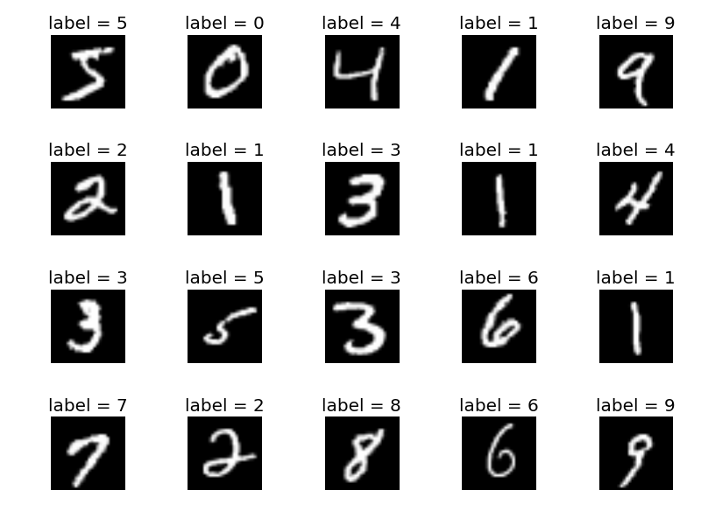
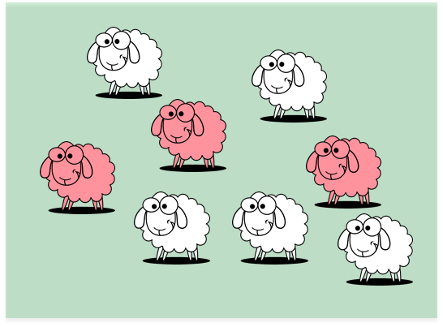
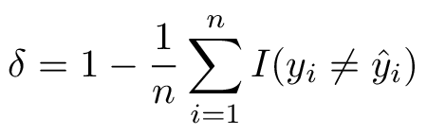
Settings and Rules
Classification problem with i.i.d. data
Accuracy: Fraction of correctly classified points
To avoid bias use the test set only once
Resampling & Model Evaluation
Özgür Martin

Slide 19
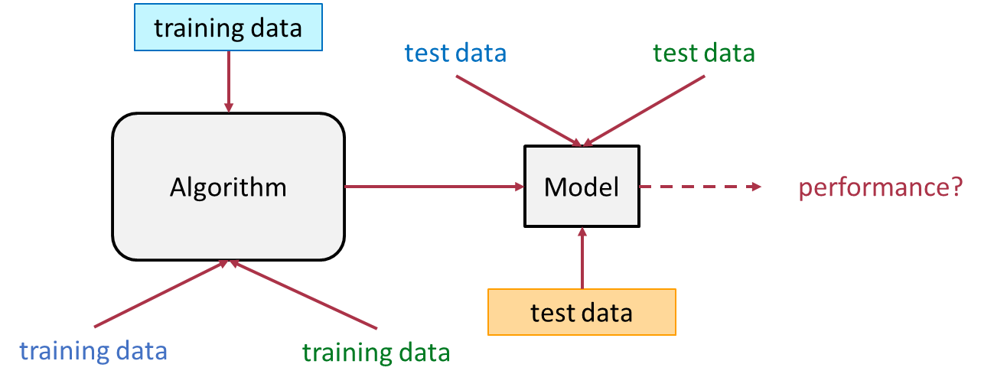
Generalization Performance
(algorithm and its parameters are fixed)
Resampling & Model Evaluation
Özgür Martin

Slide 20

Holdout
Data
TR
TE
TR
TE
Algorithm
Model
Training
(model fitting)
Testing
Data
How about uncertainty
due to random data split?
Final Training
Final
Model
deploy
Resampling & Model Evaluation
Özgür Martin

Slide 21


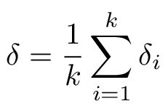
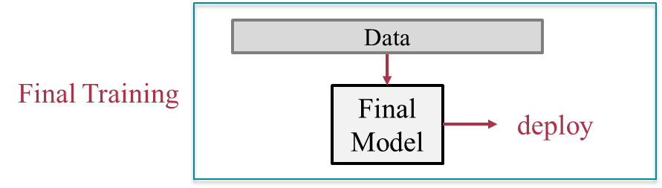
Repeated Holdout
Data
TR
TE
TR
TE
TE
Data
Algorithm
TR
TE
TE
TE
TR
TE
TR
TE
TE
Model
…
Data
TE
TR
TE
TR
Resampling & Model Evaluation
Özgür Martin

Slide 22
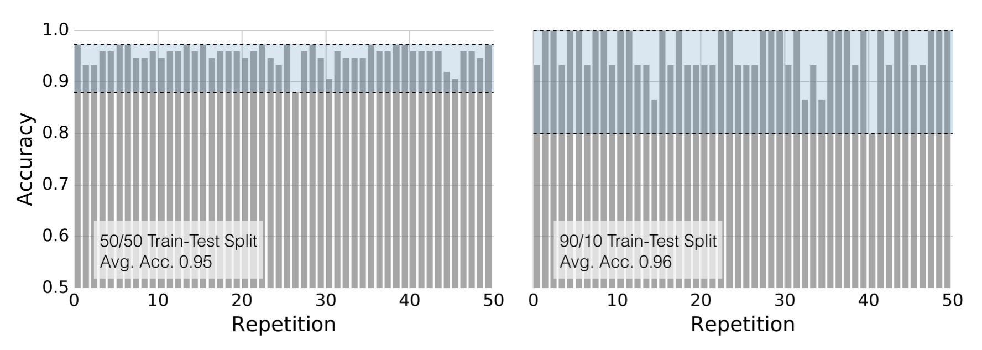
Notes on (Repeated) Holdout
Single split: point estimate (high variance)
Repeated splits: mean estimate (low variance)
Large Test Set – Pessimistic Bias vs. Small Test Set – High Variance
Stratification: Preserving the class ratios in training and test sets
Other resampling methods: cross-validation, bootstrap
*
* Model Evaluation, Model Selection, and Algorithm Selection in Machine Learning, S. Raschka, arXiv:1811.1280v2, pg.15, 3 Dec 2018. (link)
Resampling & Model Evaluation
Özgür Martin

Slide 23
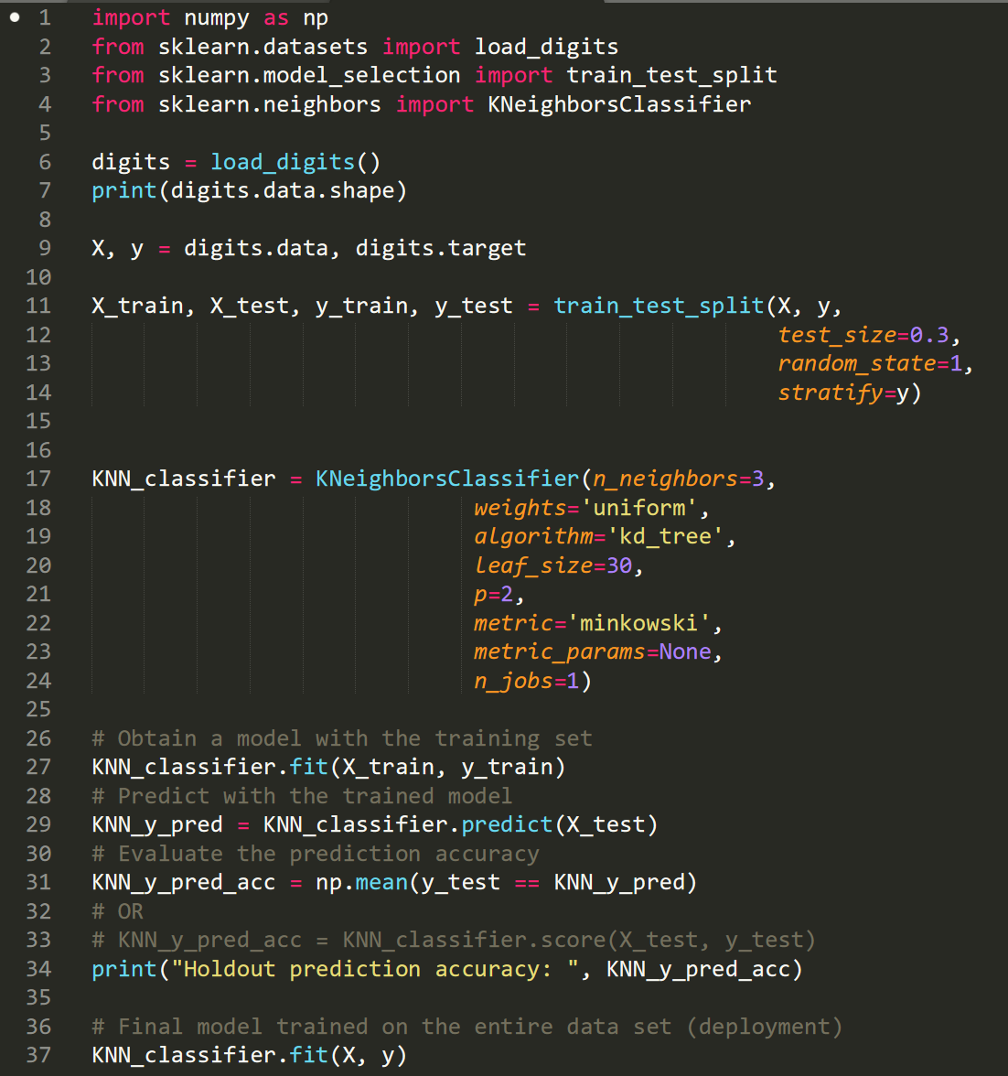
In Action (holdout)
adding packages and functions
loading MNIST data set
stratified data splitting
(training: 70% - test: 30%)
fixed algorithm (K-NN)
fixed hyperparameters
model is trained
model is tested
performance evaluated
final model is obtained
Resampling & Model Evaluation
Özgür Martin

Slide 24
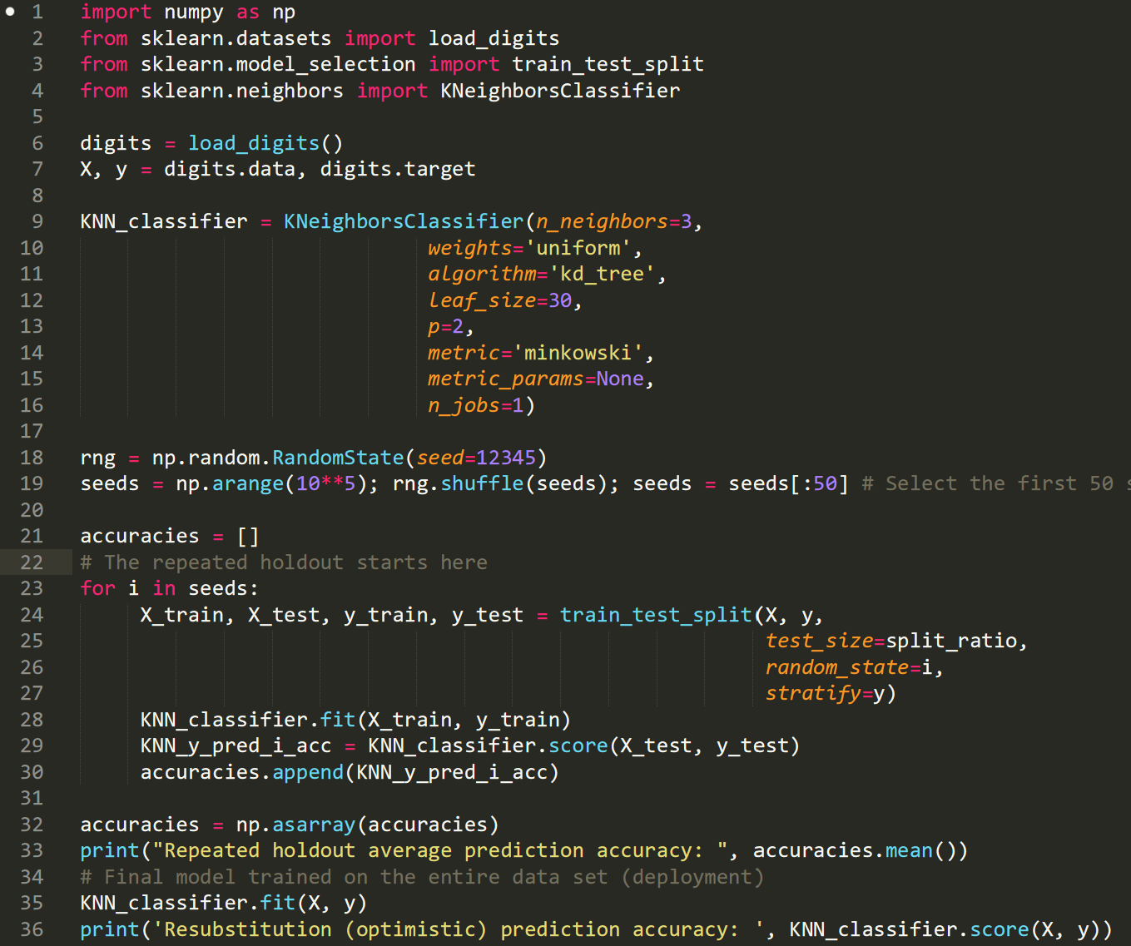
In Action (repeated holdout)
adding packages and functions
loading MNIST data set
fixed algorithm (K-NN)
fixed hyperparameters
random seeds for repetitions
stratified data splitting
(training: 70% - test: 30%)
each model is trained and tested
average performance reported
final model is obtained
Resampling & Model Evaluation
Özgür Martin

Slide 25
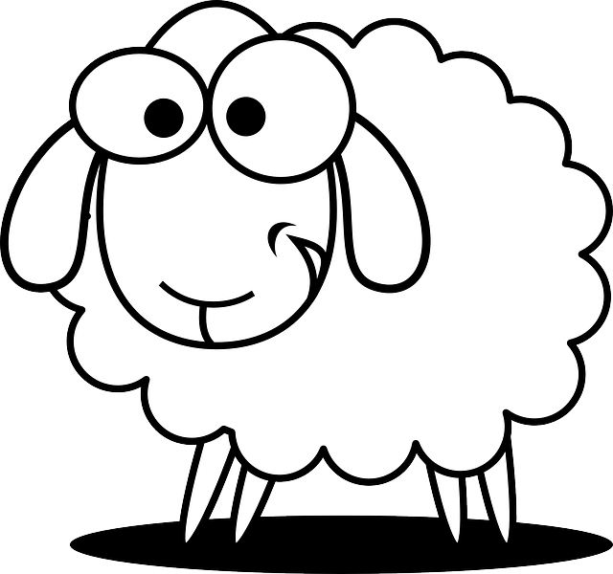
Resampling
Stratification
Data
TR
TE
Resampling & Model Evaluation
Özgür Martin

Slide 26
Resampling
Cross-Validation (CV)
one data
point
Data
Leave-One-Out Cross-Validation
(LOOCV)
TR
TE
TE
Data
n-folds
TE
TR
TE
TR
…
Data
TE
TR
TE
Data
k-Fold Cross-Validation
TE
TR
TE
Data
k-folds
TE
TR
TE
TR
…
Data
TE
TE
TR
Data is often shuffled before applying CV
Resampling & Model Evaluation
Özgür Martin

Slide 27
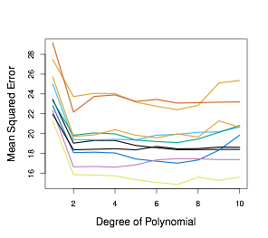
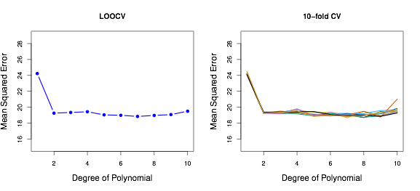
k = 2
k = 10
k = 2
k = n
Validation Set Approach
10-Fold Cross-Validation
Leave-One-Out Cross-Validation
Resampling & Model Evaluation
Özgür Martin

Slide 28
k-fold Cross-Validation
Data
TR
TR
TE
TE
TE
Data
Algorithm
TR
TE
TE
TR
Model
…
Data
TE
TE
TR
Resampling & Model Evaluation
Özgür Martin

Slide 29
Repeated Holdout vs. k-fold Cross-Validation
Data
Data
TR
TR
TE
TR
TE
TE
Data
Data
TR
TE
TR
TR
TE
TR
TE
TR
TE
TR
…
…
Data
Data
TE
TR
TE
TR
TE
TR
TE
Resampling & Model Evaluation
Özgür Martin

Slide 30
Resampling
Resampling
Bootstrap
Bootstrap
with replacement
training set sample size is n
the rest (out-of-bag) can be used for testing
training set can be used for testing (resubstitution)
allows collection of statistics (e.g., variance of regression parameters)
plays nicely with small data sets
1
2
3
n
3
9
5
3
3
9
8
9
5
12
1
2
1
9
5
6
1
37
Resampling & Model Evaluation
Özgür Martin

Slide 31
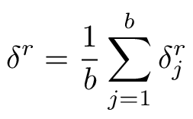
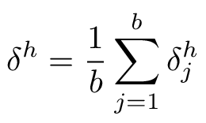
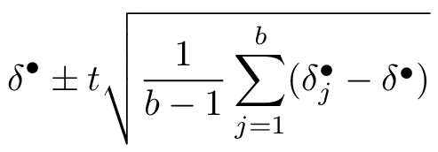

Resampling
Bootstrap
optimistic bias
pessimistic bias
resubstitution
accuracy
holdout
accuracy
confidence interval
(under normality assumption)
Resampling & Model Evaluation
Özgür Martin

Slide 32
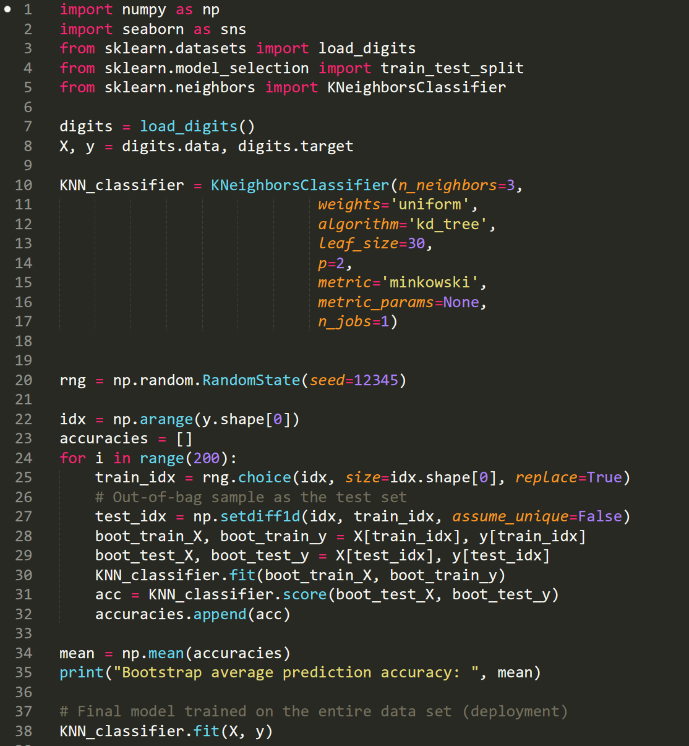
In Action (bootstrapping)
adding packages and functions
loading MNIST data set
fixed algorithm (K-NN)
fixed hyperparameters
random seeds for bootstrapping
sampling with replacement (training set)
marking rest for testing
each model is trained and tested
average performance evaluated
final model is obtained
Resampling & Model Evaluation
Özgür Martin

Slide 33
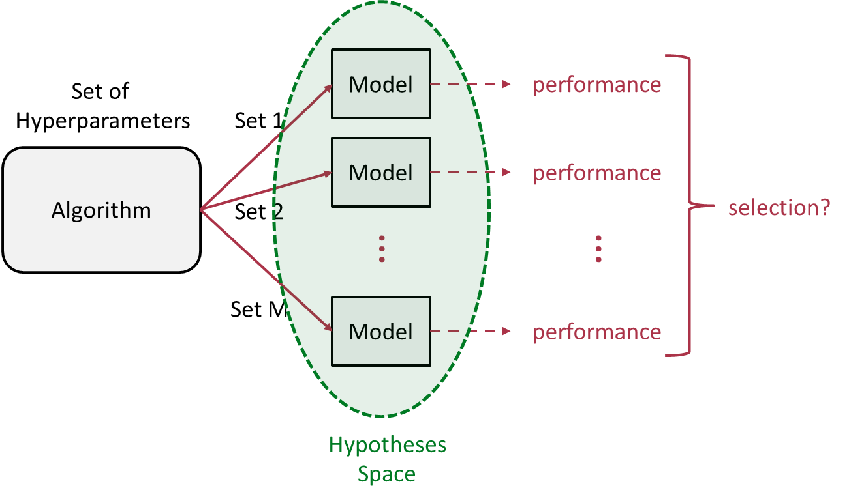
Model Selection
(algorithm is fixed, its ‘best’ parameters are sought)
Resampling & Model Evaluation
Özgür Martin

Slide 34



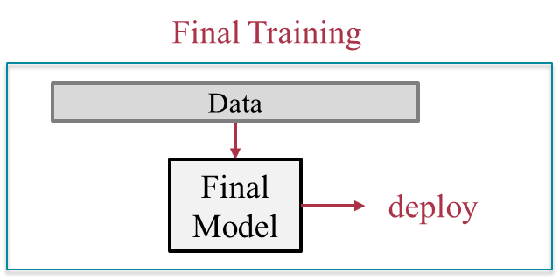
Three-way Holdout
Data
TR
VA
TE
TR
VA
Algorithm
Hyperparameter
Set j
Model j
TR
VA
TE
Algorithm
Hyperparameter
Set j*
Model
Resampling & Model Evaluation
Özgür Martin

Slide 35
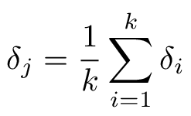
k-fold Cross-Validation
Data
TR
TE
TR
TR
TR
VA
VA
TR
Algorithm
Hyperparameter
Set j
TR
VA
TR
Model j
…
TR
VA
TR
TR
TE
Algorithm
Hyperparameter
Set j*
Model
Resampling & Model Evaluation
Özgür Martin

Slide 36
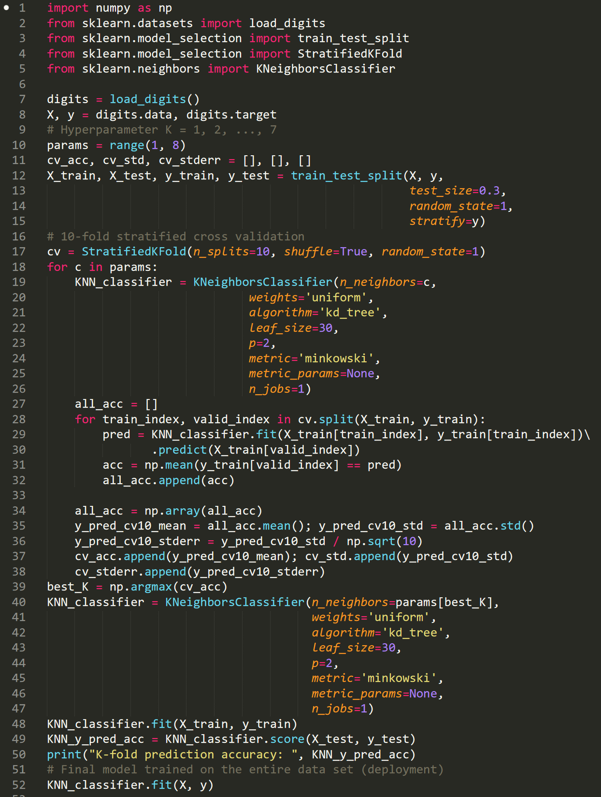
In Action (k-fold CV)
adding packages and functions
loading MNIST data set
range of hyperparameters
stratified data splitting (70% - 30%)
preparing 10-fold cross-validation
fixed algorithm (K-NN)
different hyperparameters
applying 10-fold cross-validation
collecting statistics
training with the ‘best’ parameter
performance evaluated
final model is obtained
Resampling & Model Evaluation
Özgür Martin

Slide 37
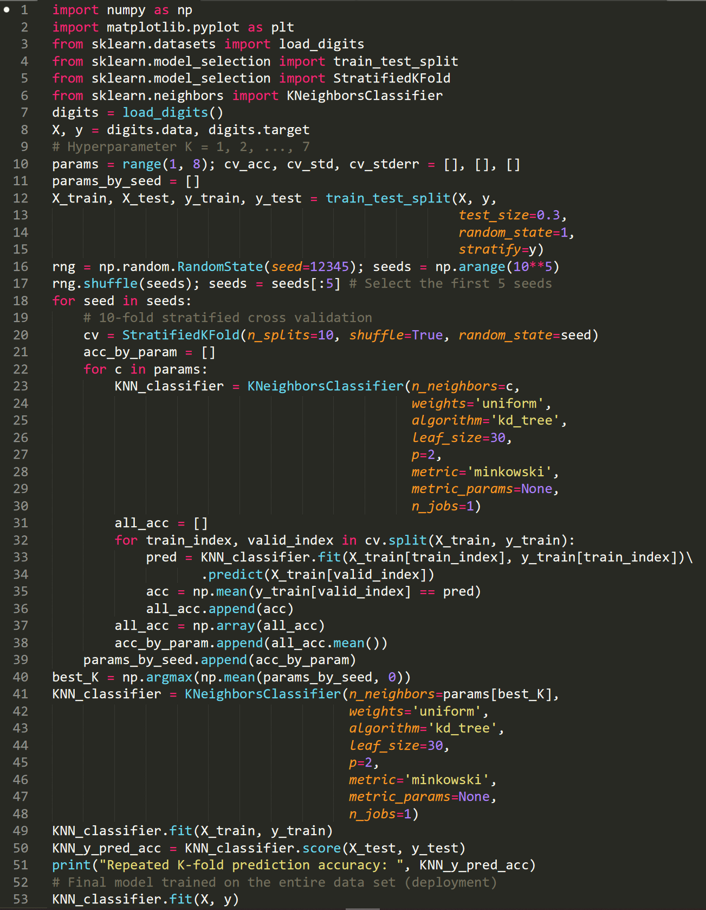
In Action (repeated k-fold CV)
adding packages and functions
loading MNIST data set
range of hyperparameters
stratified data splitting (70% - 30%)
random seeds for repetitions
preparing 10-fold cross-validation
with different seeds
fixed algorithm (K-NN)
different hyperparameters
applying 10-fold cross-validation and collecting statistics
training with the ‘best’ parameter
performance evaluated
final model is obtained
Resampling & Model Evaluation
Özgür Martin

Slide 38
Model Selection Notes
Overall generalization performance depends on the test set
k-fold CV takes a long time with large data sets (or slow algorithms)
Three-way holdout is faster when data set is large
Holdout method is occasionally called as 2-fold CV (not exactly true)
There is no universal k value in k-fold CV (usually 5 or 10, though)
Roughly: LOOCV (small data set), k-fold CV or three-way holdout (large data set)
Resampling & Model Evaluation
Özgür Martin

Slide 39
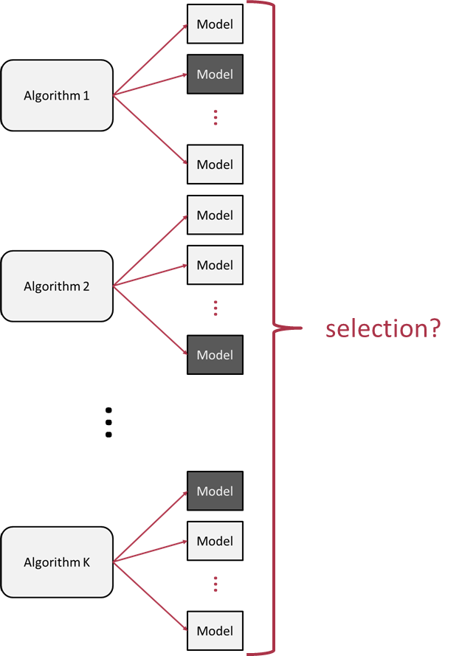
Algorithm Selection
Resampling & Model Evaluation
Özgür Martin

Slide 40

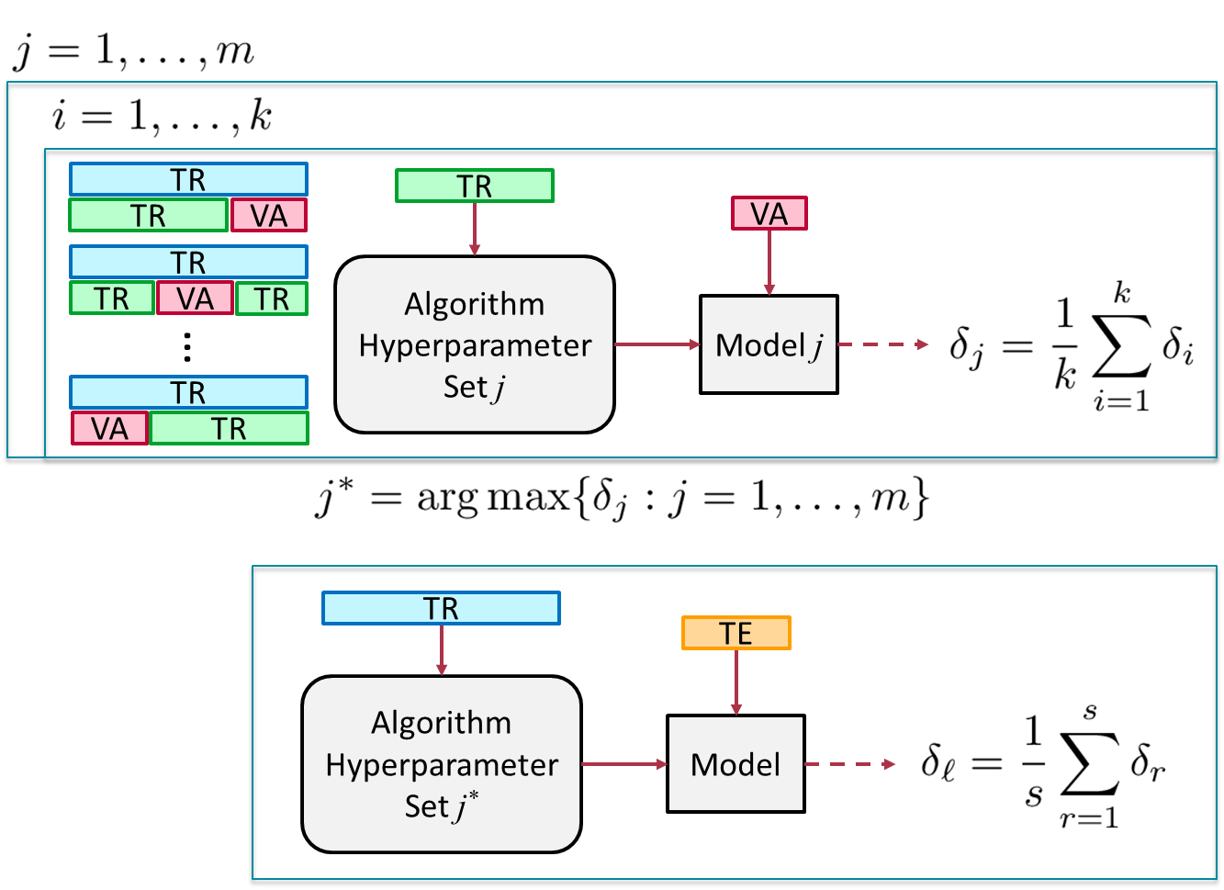
Nested k-fold Cross-Validation
Data
TR
TE
Data
TR
TE
TR
…
Data
TE
TR
Then select the best performing algorithm among K
Resampling & Model Evaluation
Özgür Martin

Slide 41
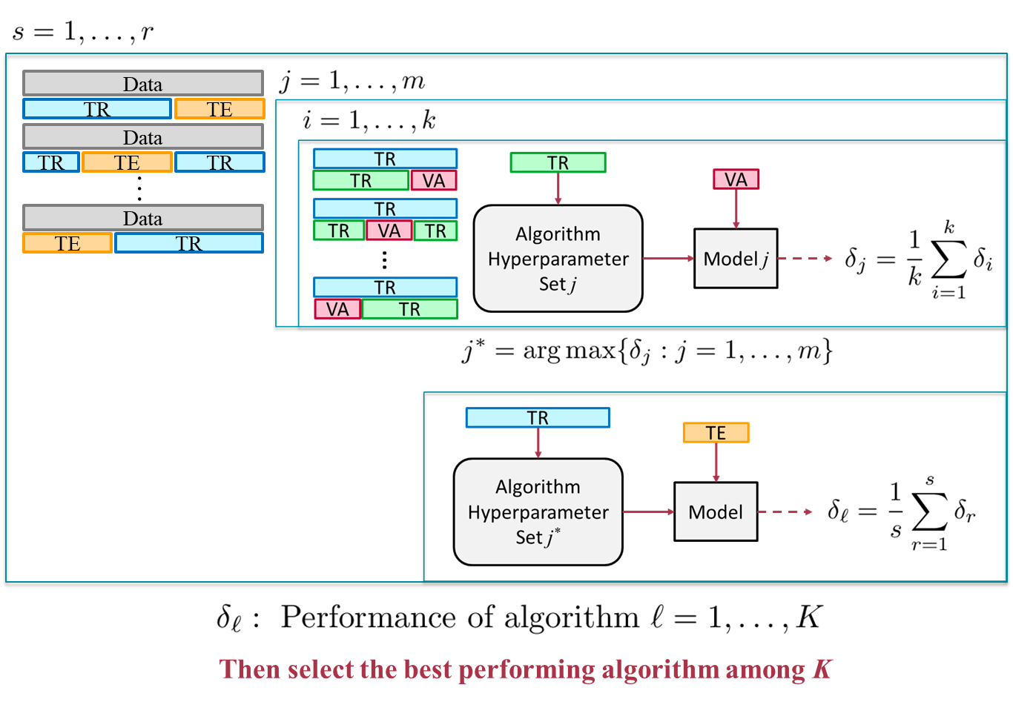
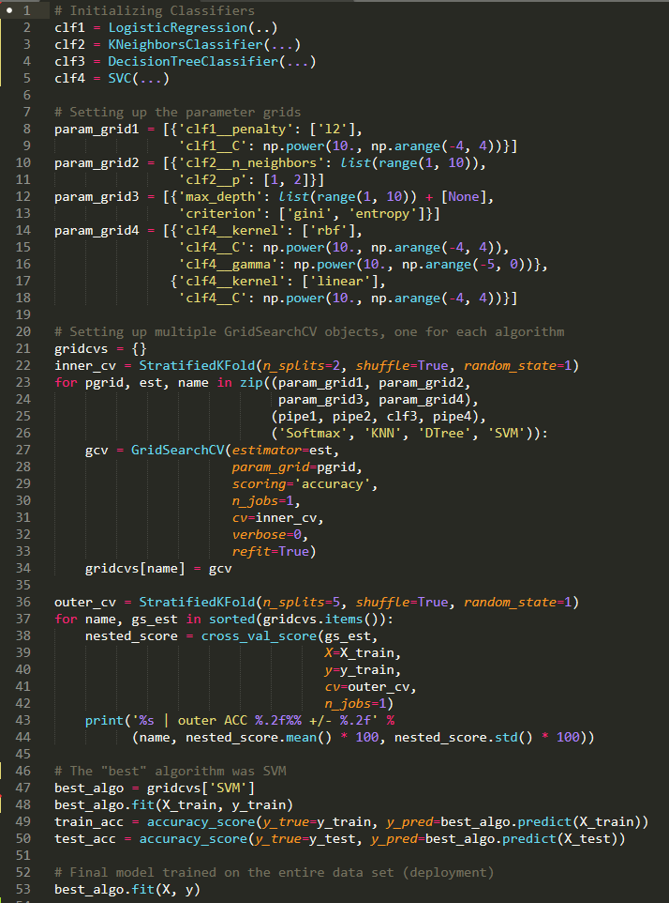
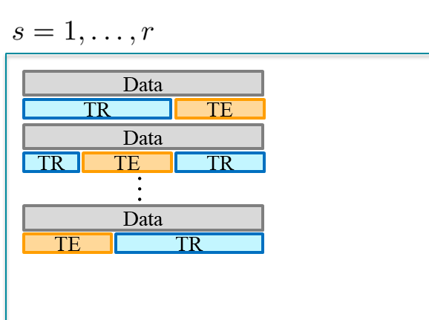
In Action (nested k-fold CV)
contender algorithms
setting hyperparameter sets
performance of the best algorithm evaluated
final model is obtained
Resampling & Model Evaluation
Özgür Martin

Slide 42
Summary
Generalization performance
Model selection (hyperparameter tuning)
Holdout methods
Resampling: bootstrapping, cross-validation
Algorithm selection
Difference tests
Other methods
Resampling & Model Evaluation
Özgür Martin

Slide 43
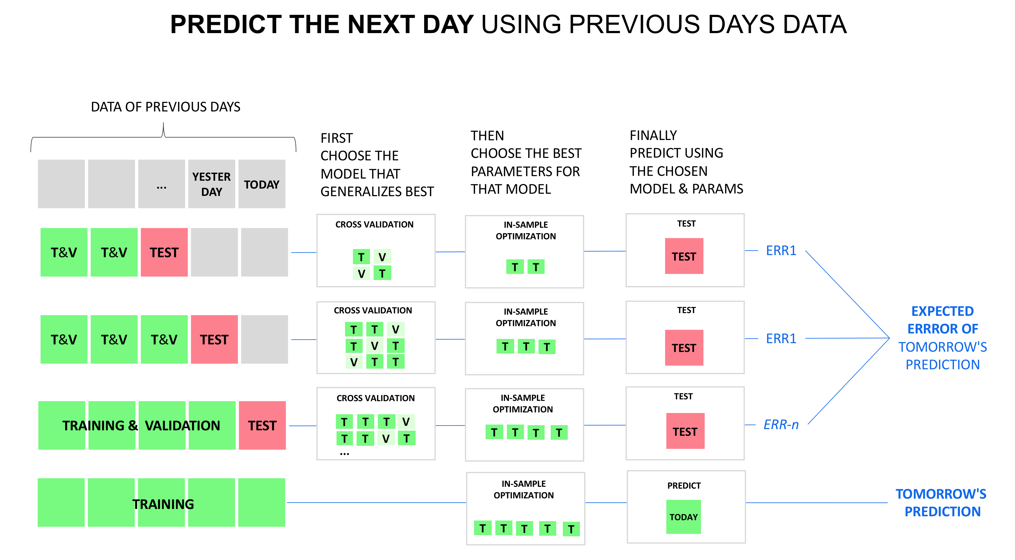
Resampling & Model Evaluation
Resampling & Model Evaluation
Özgür Martin

Slide 44
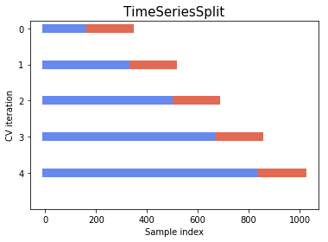
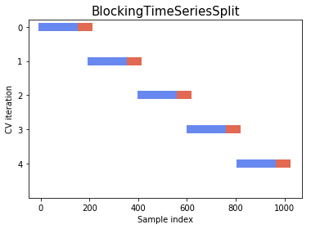
Resampling & Model Evaluation
Özgür Martin

Slide 45
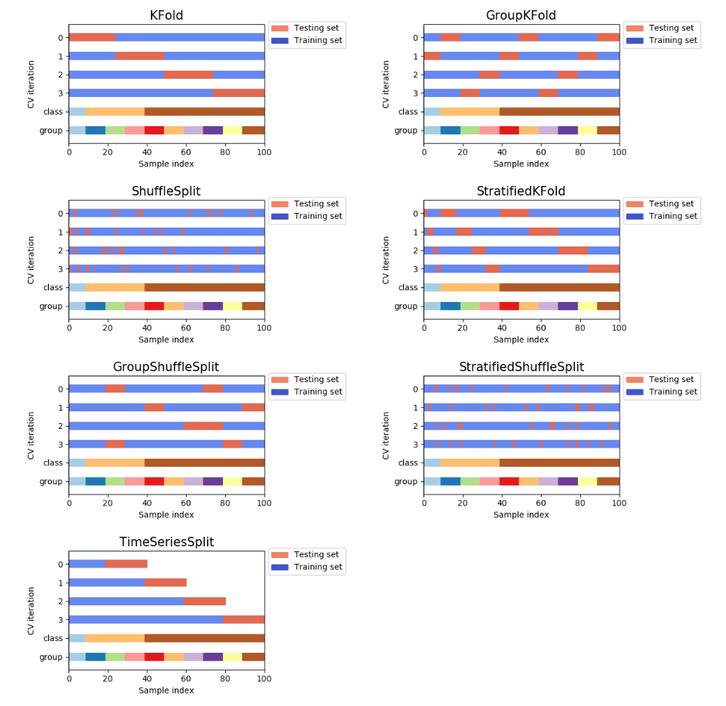
Resampling & Model Evaluation
Özgür Martin

